Slide 1

8598 Tips and Tricks: Domino and Javascript development masterclass
Paul Withers, Intec Systems Ltd
John Jardin, Agilit-e

Slide 2

paul Withers
ICS Developer, Intec Systems
OpenNTF Board Member
IBM Champion
@paulswithers
Notes Developer
XPages Developer
Java Developer
Microservices Developer

Slide 3

John Jardin
CTO, Agilit-e
IBM Champion (Cloud and ICS)
@JohnJardinCodes
Integration & Cloud Architect
XPages Developer
DevOps Engineer
AI Programming

Slide 4
agenda
Introduction
Domino as datastore, REST access
What about scheduled tasks?
Microservices For Domino
Containerization and Clustering

Slide 5
introduction

Slide 6
This session?
IS NOT:
How to write your app using XYZ JavaScript framework and package it in the NSF
A first step in ultimately migrating away from a Notes and Domino ecosystem
IS:
How to develop and include Domino as the datastore for a microservices architecture (Notes: Also an API Gateway and Domino is the Master for the microservice environment)
About embracing new Tools and Technologies
A mindshift in thinking (Note: Find a nice way to say this)

Slide 7
Domino the monolith?
Domino for Directory Management
Domino TLS
Domino HTTP Server / Port 1352
NoSQL Data Store (NSF)
UI, MVC and Data (NSF)
Domino languages for workflow (LS / SSJS / Java)
nupdate for indexing
Domino replication / clustering
Standard templates for auditing (log.nsf etc)
Domino SMTP for mail routing

Slide 8
The reality
LDAP as an alternative for Directory Management
nginx / IBM HTTP Server on top of Domino
ODBC / JDBC / LEI / agents processing flat files
Web Services / agents to connect externally
Lotus Workflow for BPM
Third-party tools for better auditing (incl. OpenLog)
Export to data warehouse / NotesSQL for reporting
Mail routing via non-Domino SMTP server

Slide 9
Mutato nomine de te fabula narratur
Domino has always been in the “microservices” game
Custom workflow around ERP processes
Custom integration for multiple non-Domino systems
Configuration pulled from external systems

Slide 10
Change your thinking
Pros
Greater flexibility
Best of breed
Increased standardisation
Cons
Code for failure
Step outside comfort zone
Integration points

Slide 11
Domino as datastore – REST Access

Slide 12
Domino rest options
DAS (Domino Access Services)
validation / visibility concerns
XAgents
viewState=“nostate”
SmartNSF
written using Domain Specific Language
ODA Starter Servlet
develop in Eclipse, local Domino server
Darwino Microservices

Slide 13
REST VS API
API-first approach means
Longer initial development lifecycle
Increased portability
Better separation between database and interface
Easier extensibility into other systems
Code for failure and “bad data” – ON BOTH SIDES
Missing parameters
Invalid enums

Slide 14
REST VS API CONT.
Security considerations
How to restrict access to apps: API key, OAuth?
Use header / query params correctly
Secure e.g. scheduled endpoints differently
Additional logging of transactions?
Be careful what you expose
Should your “status” field be editable
Or just set via workflow methods

Slide 15
documentation
Swagger / Open API Specification is standard
Swagger Editor online, local node.js app or Docker
OpenAPI 3.0 released July 2017
Samples not yet updated
Swagger 2.0 has many examples
Swagger Hub or tools like Mermade will convert (between the 2)
Swagger UI allows testing against actual server
Swagger mock server can be created (For?)

Slide 16
Creating a swagger definition
Write as YAML or JSON
YAML – no quotes around strings, no commas, no curly braces
operationIds can be added
If used, required on all for that path
Use enums for options
OpenAPI 3.0 allows examples, but clarify and add value
“Framework for good documentation”, does not guarantee good documentation

Slide 17
testing
Various REST service tools are available
Postman (Electron desktop app)
RestClient plugin for Firefox

Slide 18
http Request Types
GET – No body data allowed (Ready only)
POST – Submit data (Read/Write)
PUT– Replacing entire document data
PATCH – Minor update to existing data
DELETE – Deleting Records (No body data allowed)

Slide 19
HTTP status codes
1xx – Received and understood, stand by…
2xx – Received, understood and accepted
3xx – Redirecting
4xx – You did something wrong!
5xx – We did something wrong!
See Wikipedia

Slide 20
http status codes CONT.
200 – OK
202 – Accepted for processing
302 – URL found but server is redirecting
400 – Bad request
401 – Unauthorised
403 – Forbidden
404 – Not found
405 – Method not allowed
500 – Internal server error

Slide 21
What about scheduled tasks?

Slide 22
Scheduled tasks
Scheduled Agents
NSF only, language constraints (LS or Painful Java)
DOTS
Server only, deployment constraints
How about a different approach?

Slide 23
API + node-red = flexibility
API
XAgent / SmartNSF / or REST endpoint
Use Xots for background processing
Utility methods added to ODA to boilerplate code
Node-RED
Scheduling of flows that includes Web APIs
Other schedulers would work, as long as they can call a Web API

Slide 24
Node-red
An integration tool for wiring together APIs and online services
Available on IBM Cloud, local node.js app or Docker
Note: Docker containers not aware of host’s “localhost” or other containers
Schedule tasks via Inject node (or Big Timer)
Basic authentication can be set
Flows can be imported / exported as JSON

Slide 25
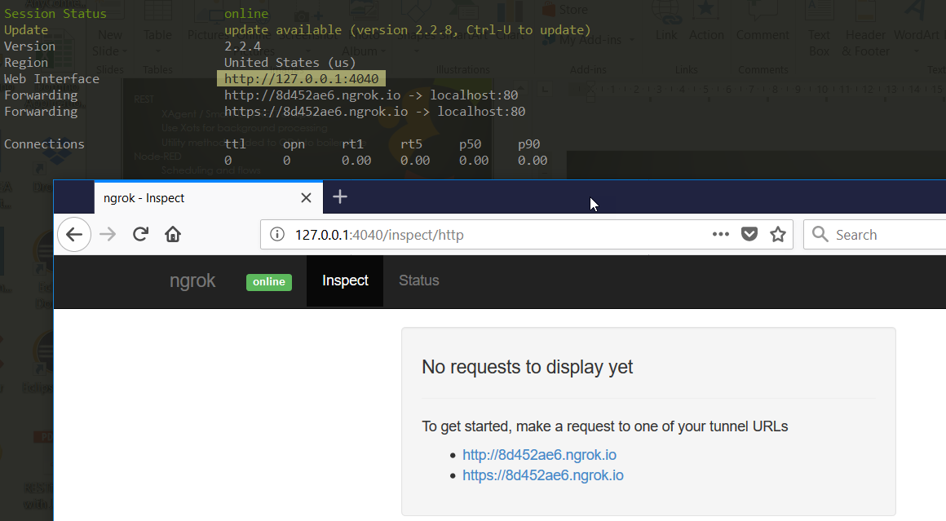
Integrating private / public
“Private” needs to be made “public”
ngrok provides secure tunnels
cmder is a good console emulator for Windows

